Slide 1

EVIL TWIN ATTACK AND CAPTIVE PORTAL
PROJECT II
Lecturer: Nguyen Duc Toan
Full name: Phạm Đặng Tấn Dũng
MSSV: 20225569

Slide 2
PROJECT INTRODUCTION

Slide 3

PROJECT INTRODUCTION
Develop a rogue Access Point similar to Hust wifi.
Project outline:
- Hardware and software setup
- Attack scenario
- Deauthentication attack
- Phishing implementation
- Conclusion

Slide 4
SETUP

Slide 5


SETUP
Setup:
- Oracle VirtualBox
- Ubuntu Linux 64-bit
- USB Atheros AR9271
Tools:
- hostapd, dnsmasq, iptables
- Axum web framework(Rust)
- PostgreSQL database

Slide 6
ATTACK SCENARIO

Slide 7





Packet Flow Analysis
Receives deauthentication frame(1)
Strong signal(4)
Scan for available WiFi(3)
Disconnects from AP(2)
Manually connects(5)
Phase 1:
Attacker sends Deauthentication Management Frames (IEEE 802.11)
User sends Probe Request frames
User receives Probe Response and Beacon Frames from the rogue AP

Slide 8
Packet Flow Analysis
DNS spoofing(1)
GET generate_204(2)
HTTP 303 See Other(3)
Goes to captive portal(4)
Phase 2:
Attacker spoof DNS queries of victim
User operating system or browser checks Internet connection
User receives redirection packet and goes to captive portal in port 3000.

Slide 9
Packet Flow Analysis
Sends login form
HTTP POST(2)
HTTP 303 See Other(3)
GET success page(4)
Stores victim data in database(5)
Phase 3:
The browser automatically loads the captive portal login page (http://10.0.0.1:3000/)
HTTP POST request containing the login credentials to attacker
Victim is redirect to login success page.

Slide 10
DEAUTHENTICATION ATTACK

Slide 11
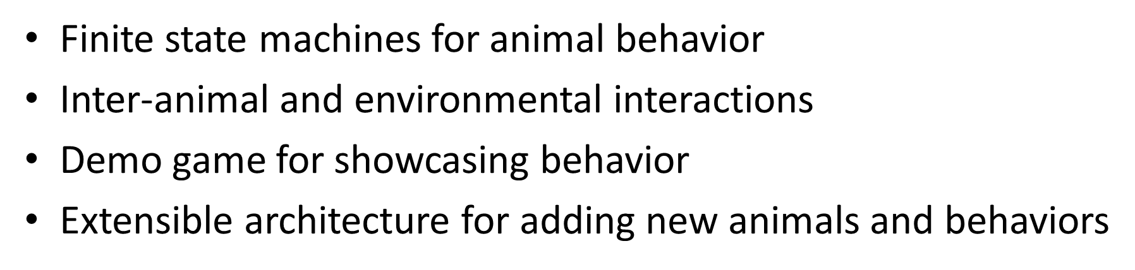
SYSTEM FEATURES

Slide 12
PHISHING IMPLEMENTATION

Slide 13
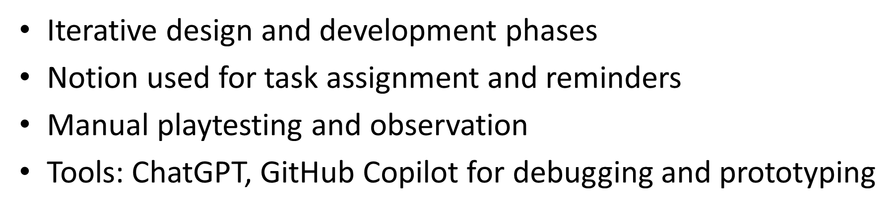

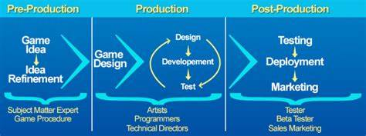
DEVELOPMENT PROCESS
The development process includes:

Slide 14
RESULT

Slide 15
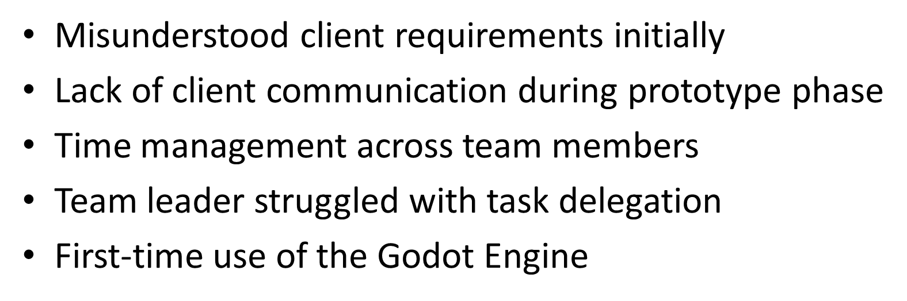

CHALLENGES
Our group encountered difficulties:

Slide 16
CONCLUSION &
FUTURE WORK

Slide 17


LESSION
What we learned from this project:
Always clarify requirements early​
Maintain regular communication with clients​
Team leaders must master planning tools​
Plan buffer time for unexpected issues​
Documentation and teamwork are essential

Slide 18
CONCLUSION
Throughout this project, we learned to:
Successfully implement a dynamic animal ecosystem​
Demonstrat realistic behavior and interaction​
Build a strong foundation for future enhancements​
Gain valuable experience in requirement management and team coordination

Slide 19
Thank you for paying attention!​

